Slide 1

UNIX FILES
Everything in Unix is Files

Slide 2

Learning Objectives
Introduction.
File Types
The UNIX and POSIX File System
The UNIX and POSIX File Attributes,
I-nodes in UNIX System V
Application Program Interface to Files,
UNIX Kernel Support for Files,
Relationship of C Stream Pointers and File Descriptors,
Directory Files,
Hard and Symbolic Links.

Slide 3

introduction
What is a file?
A file is an object on a computer that stores data, information, settings, or commands that are used with a computer program.
File operations
  Create, Open, Read, Write, Seek, Delete, …
How does the OS allow users to use files?
  “Open” a file before use
  OS maintains an open file table per process, a file descriptor is an index into this file.
  Allow sharing by maintaining a system-wide open file table

Slide 4
A computer file is a resource for storing information, which is available to a computer program and is usually based on some kind of durable storage.
What is a File System?
A file system is an organization of files into directories and folders.
There are many different types of file systems and many different implementations, which is closely linked to the type of storage device which contains the data,
e.g., a hard disk versus a thumb drive versus a CD Rom, and the operating systems, e.g., Mac, Linux, or Windows.

Slide 5
File Types
Files are the building blocks of any operating system.
When you execute a command in UNIX, the UNIX kernel fetches the corresponding executable file from a file system, loads its instruction text to memory, and creates a process to execute the command on your behalf.

Slide 6
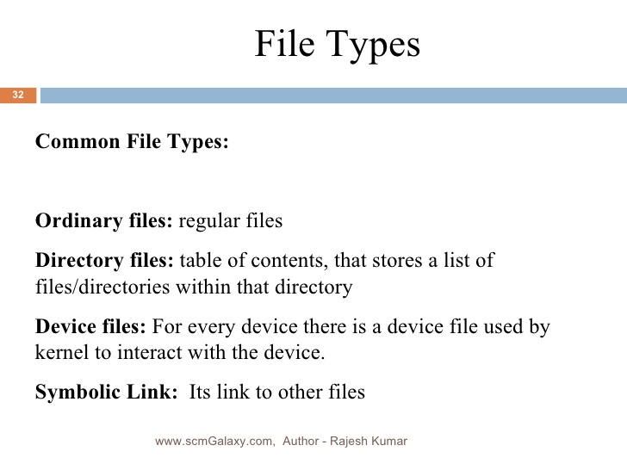

Slide 7
Regular Files
Also called as Ordinary file.
It contains the either text file or Binary file.
  binary
    GIF, JPEG, Executable etc.
  text
    scripts, program source code, documentation
Regular files may be created, browsed through, and modified – vi editor
Regular files deleted –rm command.

Slide 8
Directory Files
Directories are files folder that contains other files and sub-directories.
Directories are used to organize the data by keeping closely related files in the same place.
The directories are just like the folders in windows operating system.

Slide 9
Directory file is created by using the command mkdir and directory is deleted by using rmdir command.
The directory file is considered to be empty if it contains no other file except“.”And“..” files.

Slide 10
Device Files
These files represent the physical devices.
Device files can be divided into two types they are,
1.Block Device File.
2.Character Device File

Slide 11
Block Device File
Block device file is a type of device file that represents physical device that transmits data a block at a time.
Example:- Hard Disk and Floppy Disk.

Slide 12
Character Device File
Character device file is a type of device file that represents physical device that transmits data in a character based manner.
Example: Printers, Modem and Consoles.

Slide 13
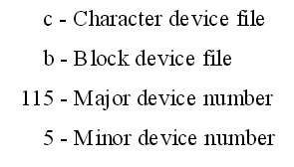
A physical device may have both block and character device files
It representing for different access methods.
A device file is created in UNIX via the mknod command.
For Character device file, use argument “c‟.
Ex: mknod /dev/cdsk c 115 5
For block device file, use argument „b‟ instead of „c‟.
Ex: mknod /dev/bdsk b 115 5

Slide 14
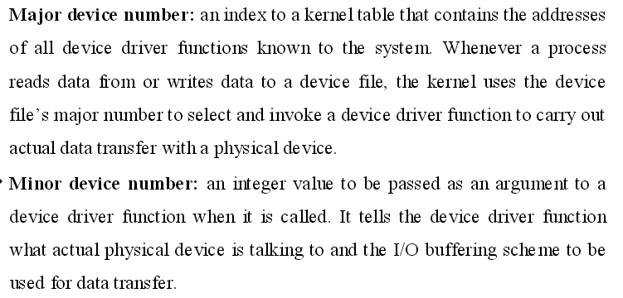

Slide 15
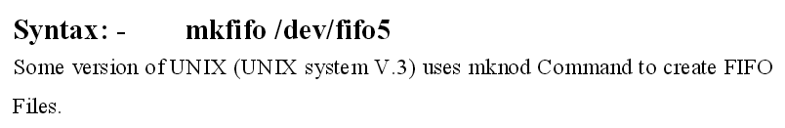
FIFO File (Named pipes)
It is a special pipe device file.
Provides temporary buffer for two or more process to communicate by writing data to and reading data from buffer.
The size of the buffer is fixed PIPE_BUF.
Once the IPC begins then only memory will be allocated for FIFO file and it becomes physically existing.
During IPC the data written to FIFO may exceed the PIPE_BUF then writer process will be blocked until a reader makes a read.

Slide 16
Symbolic Link
Symbolic Link file is a file which contains the path name.
which references another file in either local or remote file system.
Symbolic Link file is created by using the command ln including the attribute “-s”.

Slide 17
The UNIX and POSIX file systems
In UNIX or POSIX systems, files are stored or organized tree or hierarchical structure.
The root of the file system is the root directory denoted by “/” character.
Each intermediate node in a file system tree is a directory file. The leaf nodes of a file system tree are either empty directory files or other types of files

Slide 18

Hierarchical File System
In the Linux (Unix) OS, the “root directory” / is the starting directory, and other “child directories”, “grandchild directories” …etc. are created
The hierarchical structure resembles an “upside-down tree”
root /
home
etc
a
b
c
1
2

Slide 19
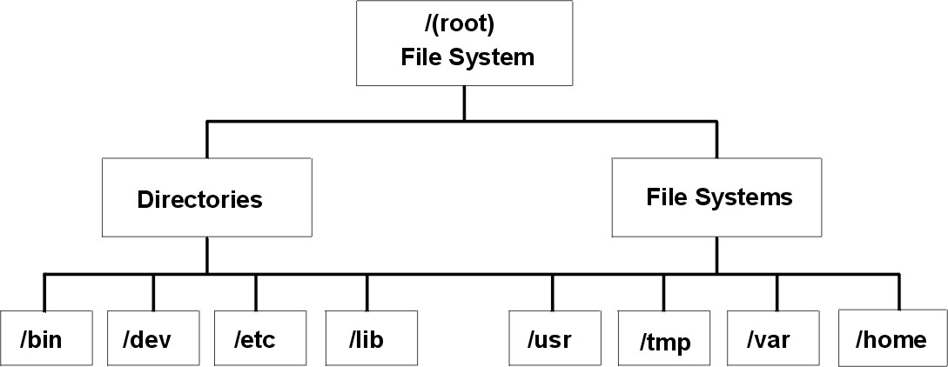

Slide 20
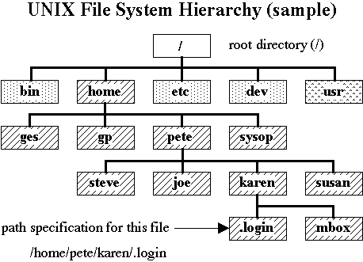

Slide 21
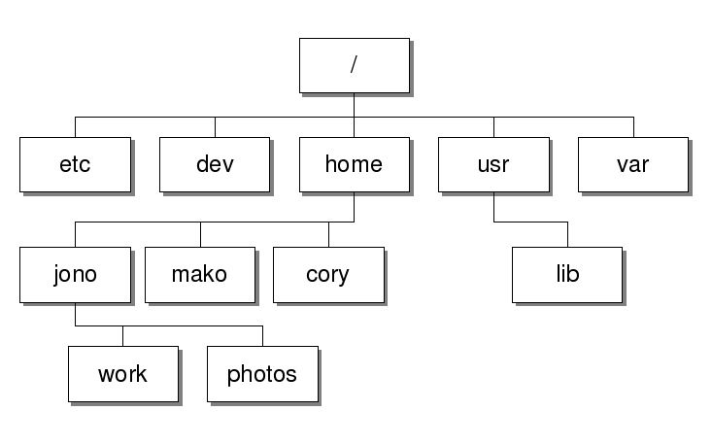

Slide 22
Typical UNIX Directories
(files are commonly defined in most UNIX systems)
/ Root directory (ancestor to all directories)
/home Used to store users’ home directories
/usr/bin Common utilities (commands) for user
/usr/sbin Common utilities for user administration
/etc General System Admin. Files (eg passwd)
/var Dynamic files (log files)
/tmp User’s temporary file for programs
/dev Device files (terminals, printers, etc…)

Slide 23
File Naming Rules
The following rules apply to naming ordinary files or “directory files”:
  Some file systems restrict filename size to 14 characters, other file systems allow for 255 characters (best to select filename size of 14)
  Can use letters (upper & lower case), numbers, period , comma or underscore _ characters
  Upper case different than lower case
  Period at beginning of filename hides file

Slide 24
Pathnames
What is a path?
A path is a unique location to a file or a folder in a file system of an OS. A path to a file is a combination of / and alpha-numeric characters.
A pathname is a listing of directories that will lead to a directory or a file.

Slide 25
Absolute vs Relative Pathnames
Absolute Pathname
  A pathname that begins from root.
  The pathname usually begins with a slash / or ~
  eg. /home/msaul/ops224
  ~/ics124/sample_tests
  (where ~ represents /home/username)
Relative Pathname
  A pathname that is “relative” to the location of another directory

Slide 26
Relative Pathnames
Rules:
  Relative pathname does NOT begin with a slash.
  Following symbols can be used:
  .. parent directory
  . current directory

Slide 27
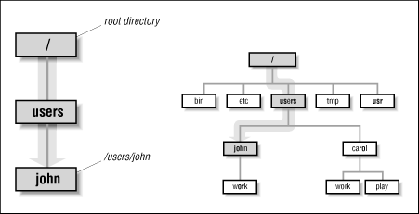
Absolute pathname

Slide 28

To make an absolute pathname:
Start at the root directory ( / ) and work down.
Put a slash ( / ) after every directory name - though if the path ends at a directory, the slash after the last name is optional
To make a relative pathname:
Start at your current directory.
As you move down the tree, away from root, add subdirectory names.
As you move up the tree toward root, add .. (two dots) for each directory.
Absolute Pathnames | Relative Pathnames
Start at the root directory. | Start at your current directory
Always start with a slash ( / ). | Never start with a slash.

Slide 29
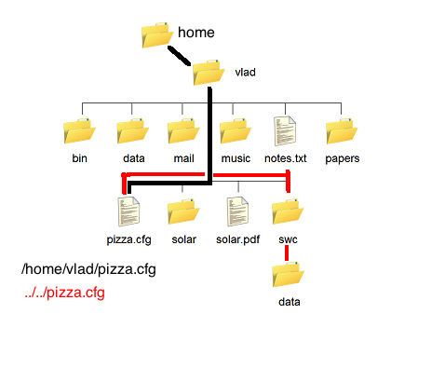

Slide 30
The UNIX and POSIX File Attributes
File systems use permissions and attributes to control the level of interaction that system processes can have with files and directories.
Viewing permissions or attributes:
Use the ls command's -l option to view the permissions and attributes.

Slide 31
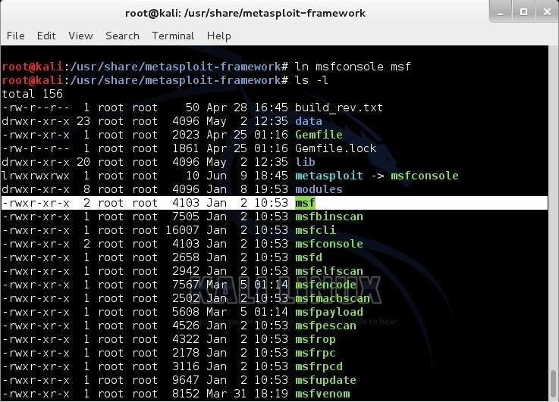

Slide 32
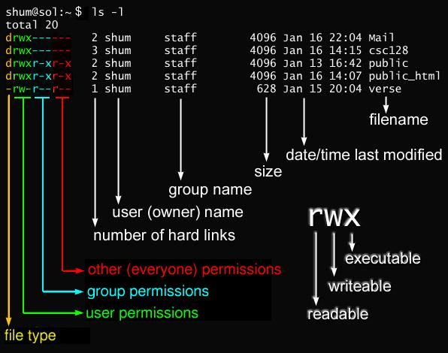

Slide 33
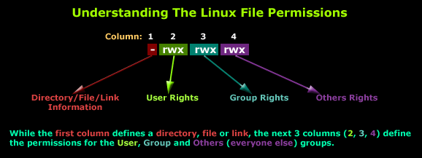
First Column
The first column is what we must focus on

Slide 34
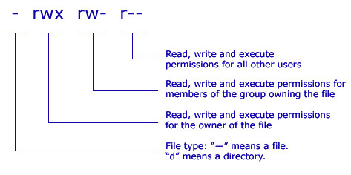

Slide 35
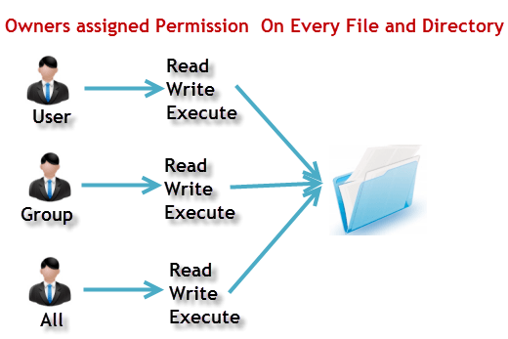

Slide 36
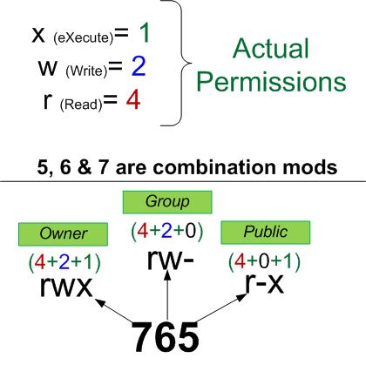

Slide 37
Other columns

Slide 38
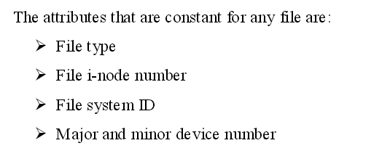
UNIX systems also store the major and minor device numbers for each device file.
All the above attributes are assigned by the kernel to a file when it is created.

Slide 39


Slide 40
inodes in UNIX System V
What is inode?
its a data structure that keeps track of all the information about a file.
You store your information in a file, and the operating system stores the information about a file in an inode(inode number).
Information about files(data) are sometimes called metadata. So you can even say it in another way, "An inode is metadata of the data."

Slide 41
Whenever a user or a program needs access to a file,
the operating system first searches for the exact and unique inode in a table called as an inode table.
The program or the user who needs access to a file, reaches the file with the help of the inode number found from the inode table.

Slide 42
To reach a particular file with its "name" needs an inode number corresponding to that file.
But to reach an inode number you don’t require the file name. In fact with the inode number you can get the data.

Slide 43
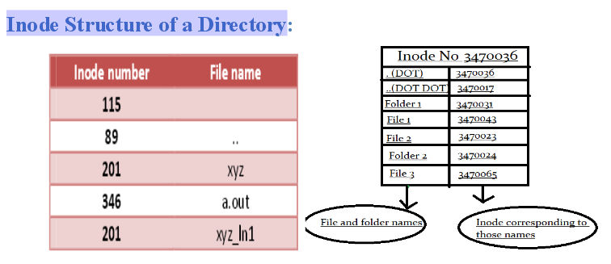
How does the structure of an inode look like?
Inode structure of a directory just consists of Name to Inode mapping of files and directories in that directory.

Slide 44

Structure of a directory entry

Slide 45
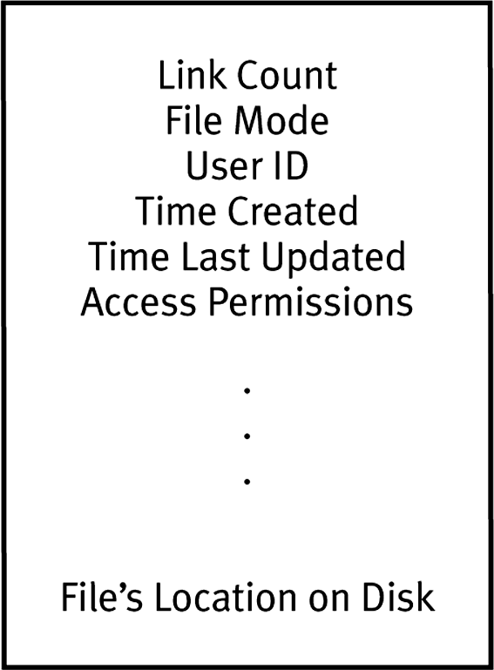
Contents of an inode

Slide 46
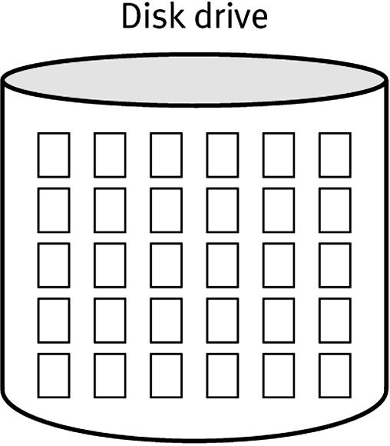
Logical view of a disk drive
(an array of disk blocks)

Slide 47
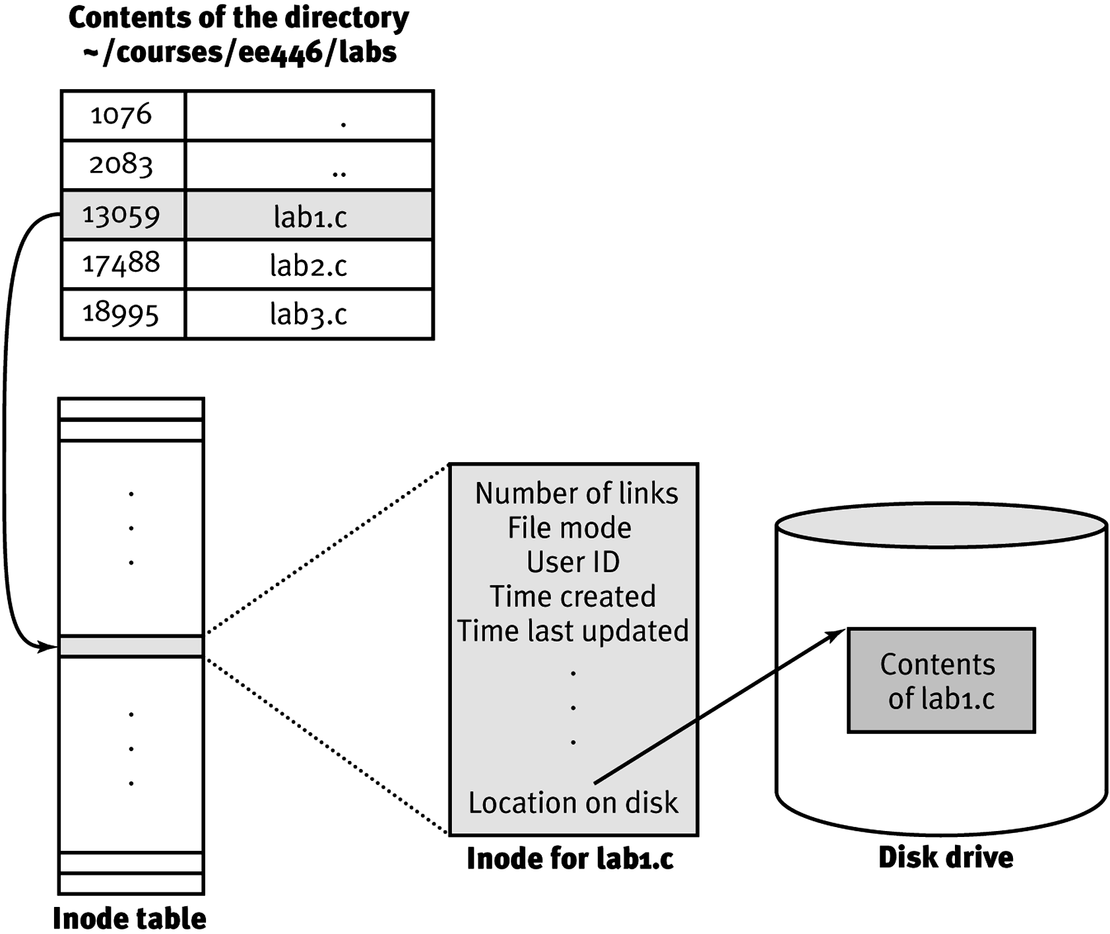
Relationship between the file lab1.c in a directory and its contents on disk

Slide 48
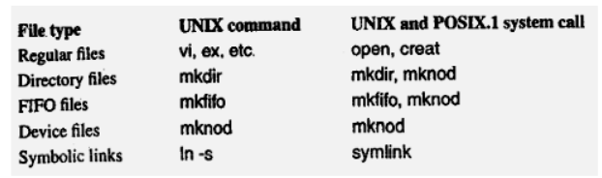
Application Program Interface to Files
The general interfaces to the files on UNIX and POSIX system are
Files are identified by pathnames.
Files should be created before they can be used. The various commands and system calls to create files

Slide 49
For any application to access files, first it should be opened, use open system call to open a file, and the returned value is an integer which is termed as file descriptor.
There are certain limits of a process to open files. A maximum number of OPEN-MAX files can be opened.
The value is defined in <limits.h> header

Slide 50
The data transfer function on any opened file is carried out by read and write system call.
File hard links can be increased by link system call, and decreased by unlink system call.
File attributes can be changed by chown, chmod and link system calls.
File attributes can be queried (found out or retrieved) by stat and fstat system call.

Slide 51
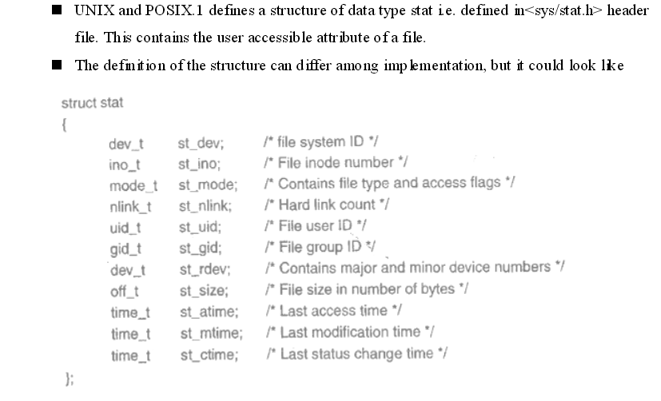

Slide 52
Hard link v/s. Soft link in Linux or UNIX

Slide 53
introduction
What are links in Unix?
A link in UNIX is a pointer to a file.
Like pointers in any programming languages, links in UNIX are pointers pointing to a file or a directory.
Creating links is a kind of shortcuts to access a file.
In UNIX, every file has a data structure (record) known as an i-node that stores information about the file, and the filename are just links and it is simply used as a reference to that data structure.

Slide 54
A link is simply a way to refer to the contents of a file.
A link is an entry in your file system which connects a filename to the actual bytes of data on the disk. More than one filename can "link" to the same data.
create a file named file1.txt:
echo "This is a file." > file1.txt
When this file was created, the operating system wrote the bytes to a location on the disk and also linked that data to a filename, file1.txt so that we can refer to the file in commands and arguments.

Slide 55
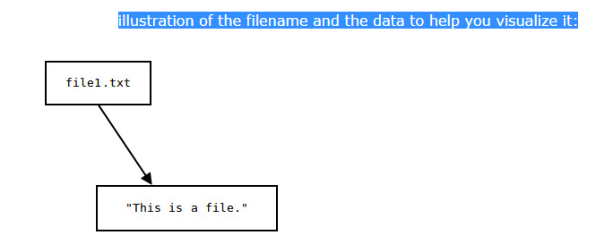
If you rename the file, the contents of the file are not altered; only the information that points to it. The filename and the file's data are two separate entities.

Slide 56
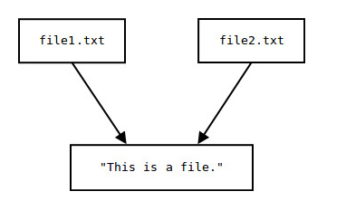
call our new link file2.txt.
The important thing to realize is that we did not make a copy of this data. Both filenames point to the same bytes of data on the disk.

Slide 57
If we change the contents of the data pointed to by either one of these files, the other file's contents are changed as well.
echo "It points to data on the disk." >> file1.txt
cat file1.txt
This is a file.
It points to data on the disk.

Slide 58
Now let's look at the second file, the one we created with the link command:
cat file2.txt
This is a file.
It points to data on the disk.
Both files show the change because they share the same data on the disk. Changes to the data of either one of these files will change the contents of the other.

Slide 59
what if we delete one of the files? Will both files be deleted?
No. If we delete one of the files, we're simply deleting one of the links to the data.
Because we created another link manually, we still have a pointer to that data;
we still have a way, at the user-level, to access the data we put in there.

Slide 60
we use the rm command to remove our first file:
rm file1.txt
it no longer exists as a file with that name:
cat file1.txt
cat: file1.txt: No such file or directory

Slide 61
But,
the link to the data we manually created still exists, and still points to the data:
cat file2.txt
This is a file.
It points to data on the disk.

Slide 62
the data stays on the disk even after the "file“ is removed. We can still access that data as long as there is a link to it.
There are two types of links:
Hard links.
Soft links (symbolic links)

Slide 63
Hard Links
Hard link is a reference to the physical data on a file system
All named files are hard links
More than one name can be associated with the same physical data
Hard links can only refer to data that exists on the same file system
You can not create hard link to a directory

Slide 64
Hard Links
Example:
  Assume you used “vi” to create a new file, you create the first hard link (vi myfile)
  To Create the 2nd, 3rd and etc. hard links, use the command:
    ln myfile link-name

Slide 65
Display Hard Links info
Create a new file called “myfile”
Run the command “ls -il” to display the i-node number and link counter
38753 -rw-rw-r-- 1 uli uli 29 Oct 29 08:47 myfile
^ ^
|-- inode # |-- link counter (one link)

Slide 66
Display Hard Link Info
Create a 2nd link to the same data:
  ln myfile mylink
Run the command “ls -il”:
38753 -rw-rw-r-- 2 uli uli 29 Oct 29 08:47 myfile
38753 -rw-rw-r-- 2 uli uli 29 Oct 29 08:47 mylink
^ ^
|-- inode # |--link counter (2 links)

Slide 67
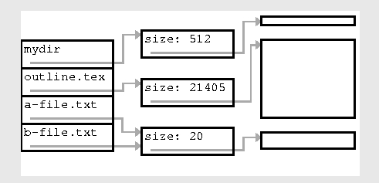
The two names a-file.txt and b-file.txt now refer to the same data
% cat b-file.txt
The file a-file.txt

Slide 68
Add the 3rd Link
Create a 3rd link to the same data:
  ln myfile newlink
Run the command “ls -il”:
38753 -rw-rw-r-- 3 uli uli 29 Oct 29 08:47 myfile
38753 -rw-rw-r-- 3 uli uli 29 Oct 29 08:47 mylink
38753 -rw-rw-r-- 3 uli uli 29 Oct 29 08:47 newlink
^ ^
|-- inode # |--link counter (3 links)

Slide 69
Removing a Hard Link
When a file has more than one link, you can remove any one link and still be able to access the file through the remaining links.
Hard links are a good way to backup files without having to use the copy command!

Slide 70

Symbolic Links
Also Known As (a.k.a.): Soft links or Symlinks
It is a file that contains the name of another file.
A Symbolic Link is an indirect pointer to a file
You can create a symbolic link to a directory
A symbolic link can point to a file on a different file system
A symbolic link can point to a nonexistent file
We can then access the contents of the other file through that name. That is, a symbolic link is like a pointer to the pointer to the file's contents.

Slide 71
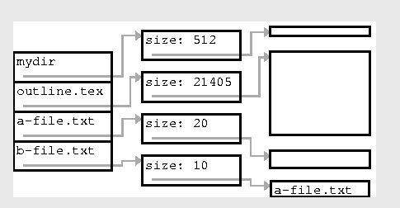
On disk, the file system would look like the following picture

Slide 72
Symbolic Links
To create a symboic link to the file “myfile”, use
  ln -s myfile symlink or
  ln --symbolic myfile symlink
[uli@seneca courses] ls -li myfile
44418 -rw-rw-r-- 1 uli uli 49 Oct 29 14:33 myfile
[uli@seneca courses] ln -s myfile symlink
[uli@seneca courses] ls -li myfile symlink
44418 -rw-rw-r-- 1 uli uli 49 Oct 29 14:33 myfile
44410 lrwxrwxrwx 1 uli uli 6 Oct 29 14:33 symlink -> myfile
Different
i-node
File type:
(symbolic link)
Link counter:
(1 link)

Slide 73
Properties of Symbolic Links
The i-node number is different from the pointed to file
The link counter of the new symbolic link file is “1”
Symbolic link file does not affect the link counter of the pointed to file
The type field of symblic file contains the letter “l”
The symbolic link file and the pointed to file have different status information (e.g. file size, last modification time etc.)

Slide 74
Create Symbolic Link Directory
The syntax is the same as linking to a file
  ln -s target_directory link_directory
  ln --symbolic target_directory link_directory
[uli@seneca week8]$ ls -li
38766 drwxrwxr-x 7 uli uli 168 Oct 29 13:32 courses
[uli@seneca week8]$ ln courses mydir
ln: `courses': hard link not allowed for directory
[uli@seneca week8]$ ln -s courses mydir
[uli@seneca week8]$ ls -li
38766 drwxrwxr-x 7 uli uli 168 Oct 29 13:32 courses
44417 lrwxrwxrwx 1 uli uli 7 Oct 29 15:41 mydir -> courses

Slide 75
The Difference Between ln And link
what about ln?
ln, creates a hard link just like link does. So this ln command:
ln file1.txt file2.txt
It is the same as the following link command:
link file1.txt file2.txt
because both commands create a hard link named file2.txt which links to the data of file1.txt.

Slide 76
the differences between soft and hard links
Soft Links:
Soft Links can be created across file systems.
Soft link has a different inode number than the original file.
On deleting the original file, soft link cannot be accessed.
Soft link needs extra memory to store the original file name as its data.
Source file need not exist for soft link creation.
Can be created on a file or on a directory.
Access to the file is slower due to the overhead to access file.

Slide 77
Hard Links:
Hard links can be created only within the file system.
Hard links have the same inode number as the original file.
On deleting the original file, hard linked file can still be accessed.
Hard links do not need any extra data memory to save since it uses links
Source file should exist.
Can be created only on files, not on directories.
Access to the file is faster compared to soft link.

Slide 78
UNIX Kernel Support for Files

Slide 79
UNIX Kernel Support for Files
Unix kernel maintains the three tables for execution of file operations such as open, read, write and close operations.
File table.
I-node table.
File descriptor table

Slide 80
File table:
it keep track(store) of all opened file list in the system.
i-node table:
it keep track(store) of the i-node most recently accessed.
File descriptor table:
When a user executes a command, a process is created by the kernel to carry out the command execution.
The process has its own data structure called File Descriptor Table.

Slide 81
Cont…
The file descriptor table stores the maximum of OPEN_MAX file entries.
it records all files opened by the process.
process calls the open function to open a file for read or write,
1. the kernel will determine the pathname to the file inode number.

Slide 82
If the file inode is not found or not possible to access the inode data due to appropriate permission:
the open call fails and returns a -1 to the process.
the file inode is found or accessible permission to the process,
the kernel will continue to establish a path from an entry in the file descriptor table, through a file table, onto the inode for the file being opened.

Slide 83
The kernel will search the process descriptor table and look for the first unused block.
If an block is found, that block will be selected(used) to reference the file.
The index of the block will be returned to the process. [These index value is the file descriptor of the opened file.]
2. The kernel will scan the file table and find out free space that can be assigned to reference the file.

Slide 84
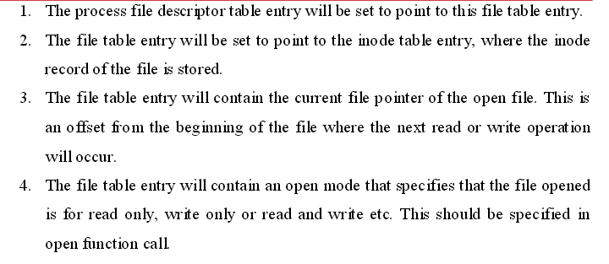
if an unused entry is found the following events will occur

Slide 85
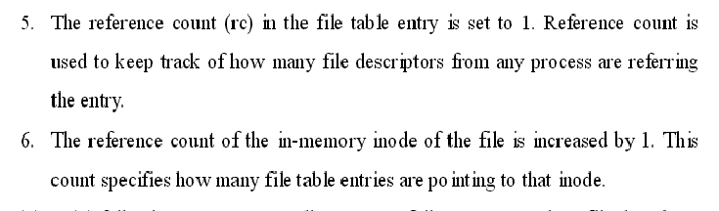
If either (1) or (2) fails, the open system call returns
-1 failure status, and no file descriptor table or file table entry will be allocated.

Slide 86
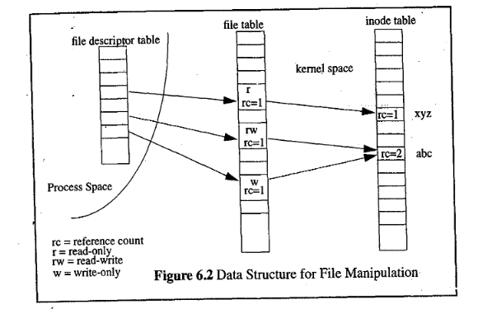

Slide 87
a process's file descriptor table, the kernel file table, and the inode table after the process has opened three files:
xyz for read-only,
abc for read-write, and
abc again for write-only.

Slide 88
The reference count of an allocated file table entry is usually 1, but a process may use the dup functions to make multiple file descriptor table entries point to the same file table entry.
The process may call the fork function to create a child process, such that the child and parent process file table entries are pointing to corresponding file table entries at the same time.

Slide 89

The reference count in a file inode record specifies how many file table entries are pointing to the file inode record.
If the count is not zero. It means that one or more processes are currently opening the file for access.

Slide 90
Once open call succeeds,
The process return integer value of open call called as file descriptor for future reference.
When the process starts read data from the file it will use the file descriptor as the first argument to read or write system call.
The kernel will use the file descriptor to index the process descriptor table to find the file table block of the opened file.

Slide 91

If the read or write operation is well-suited with the file’s open mode.
Kernel will use the pointer specified in the file table entry to access the file inode record.
Kernel will use the file pointer stored in the file table to determine where the read or write operation should occur in the file.
Kernel will checks the file type in the inode record and invokes an appropriate driver function to initiate the actual data transfer with a physical device.

Slide 92
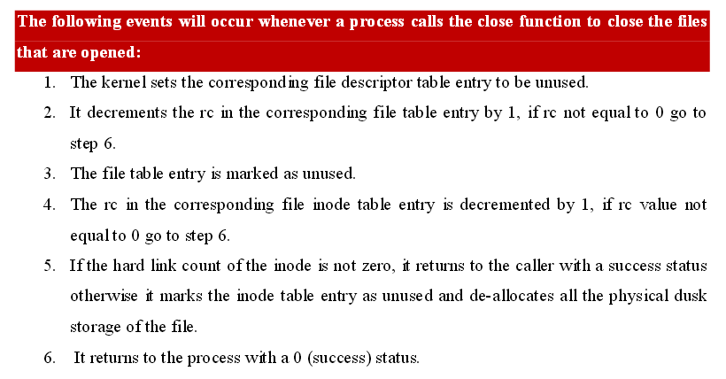

Slide 93
Relationship of C Stream Pointers and File Descriptors
File Pointer:
A file pointer is a pointer to a structure,
which contains information about the file, including its name, current position of the file, whether the file is being read or written, and whether errors or end of the file have occurred.
Syntax: FILE *fp;
This says that fp is the file pointer that points to a FILE structure.

Slide 94
Opening a file:
The fopen() function opens a stream for use and links a file with that stream.
A file pointer associated with that file is then returned by the fopen() function.
The prototype for the fopen() function is
FILE *fopen(const char* filename, const char *mode);
filename is a pointer to a string of characters that make up a valid file name and can also include a path specification.
Another parameter is a pointer to a string, name mode, determines how the file can be opened. (

Slide 95
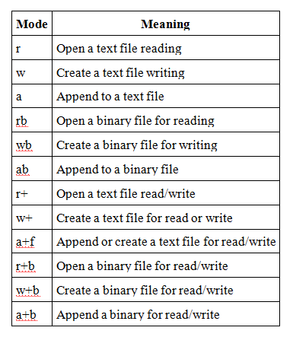

Slide 96
File descriptor
a file descriptor is an abstract indicator (handle) used to access a file.
File descriptors are an index into a file-descriptor table stored by the kernel.
The kernel creates a file-descriptor in response to an open call and associates the file-descriptor with some abstraction of an underlying file-like object; be that an actual hardware device, or a file-system or something else entirely.

Slide 97
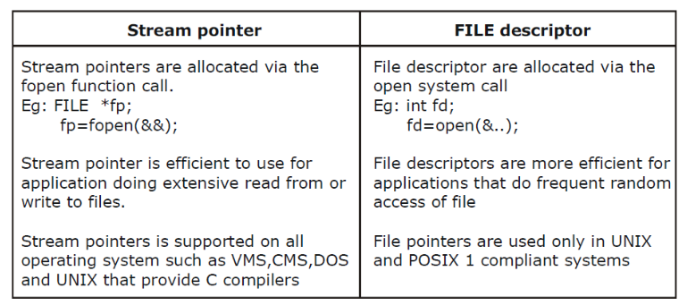

Slide 98
The file descriptor linked with a stream pointer can be extracted by fileno macro, which is declared in the <stdio.h> header.
int fileno(FILE *stream_pointer);
To convert a file descriptor to a stream pointer, we can use fdopen C library function.
FILE *fdopen (int file_descriptor, char *open_mode);

Slide 99
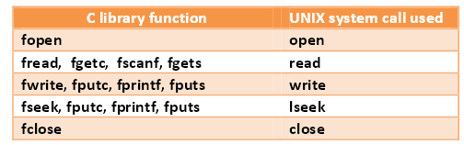
following lists some C library functions and the fundamental UNIX APIs they use to perform their functions:

Slide 100
Directory Files
It is a record-oriented file.
Each record contains the information of a file residing in that directory
The record data type is struct dirent in UNIX System V and POSIX.1 and struct direct in BSD UNIX.
The record content is implementation-dependent
They all contain 2 essential member fields
File name.
Inode number.

Slide 101
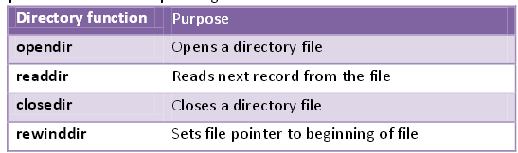

Slide 102


Slide 103


